Slide 1
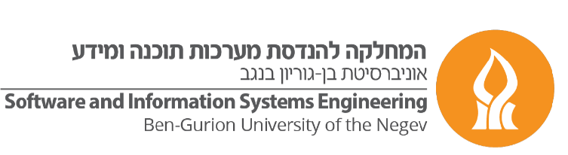


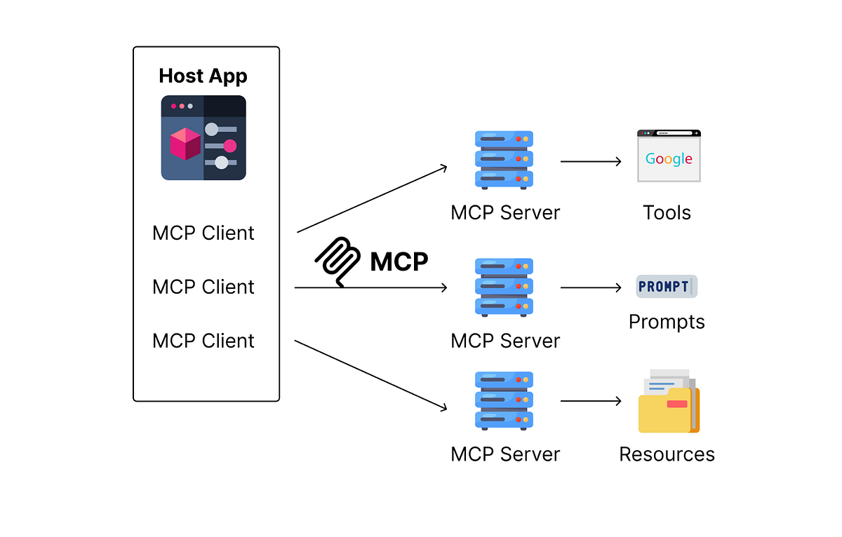
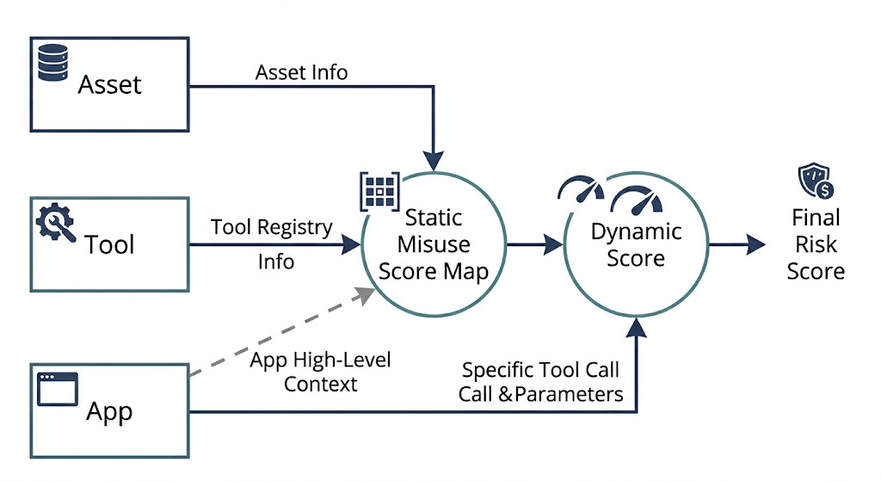
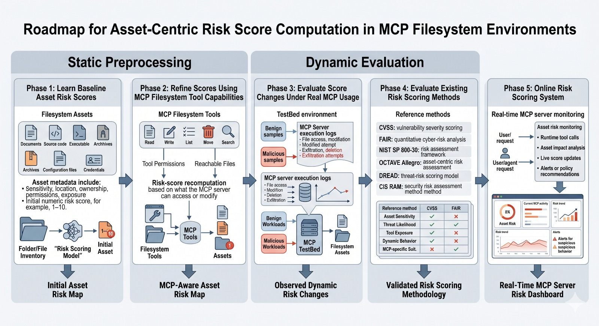
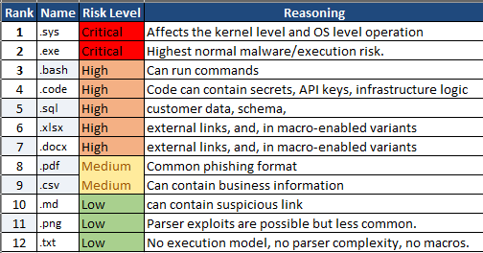
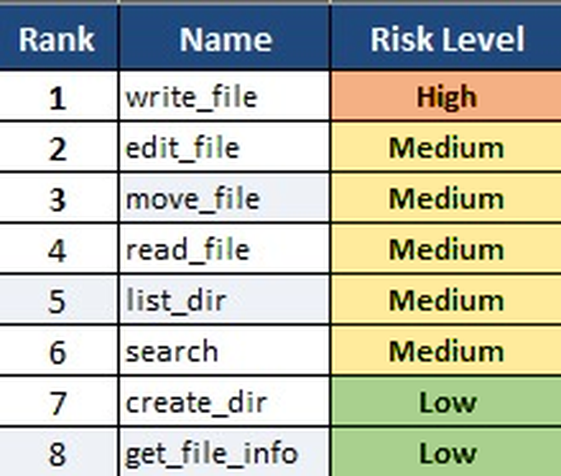
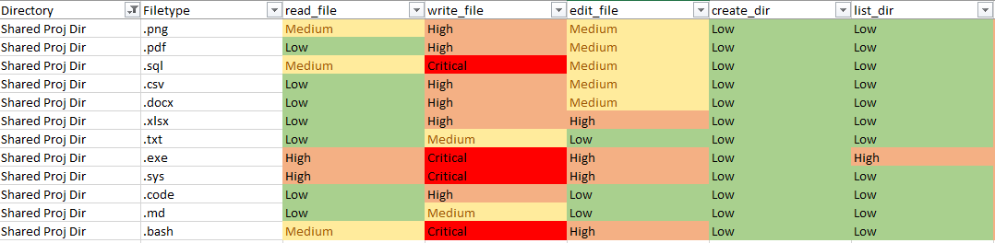
הפקולטה למדעי הנדסה
המחלקה להנדסת מערכות תוכנה ומידע
התוכנית להנדסת מערכות מידע
מס' פרויקט
33
Risk Score Computation for MCP Servers
Mr. Tomer Ovadya
Supervisors: Prof. Asaf Shabtai
1
Background
Why MCP needs a new risk model. The Model Context Protocol lets AI agents invoke server-side tools that read and modify real assets files, code, databases. This collapses the classic trust boundary: the agent and its prompts become an active threat surface acting directly on the server. Most defenses focus on the agent. We focus on the MCP server, its tools, and the assets they can reach.
Existing scores miss the point. CVSS, FAIR and DREAD rate software vulnerabilities not the misuse potential of legitimate tools acting on sensitive assets. They are static, asset-agnostic, and blind to runtime tool behavior.
We invert the model. The MCP server and its assets are the protected entity; every exposed tool is a misuse vector whose risk depends on which asset it can reach and what it can do to it.
2
3
Research Questions
Illustrative Use Case
RQ1 How can we quantify the risk a given MCP tool poses to a given asset both before and during execution?
RQ2 Does decomposing tools into atomic operations and weighting them by asset sensitivity yield risk scores more faithful than static, vulnerability-centric frameworks?
RQ3 How does incorporating runtime input values change the estimated risk of MCP tool-asset interactions compared to pre-execution risk scores?
RQ4 How does the risk score of an MCP tool operation affected by users with different roles or privileges?
Filesystem MCP server — a concrete, high-exposure testbed.
A realistic enterprise file tree exercised by both benign and malicious agent traffic.
8
Filesystem tools
8
Directory classes
12
File types
Exposed tools
read_file
write_file
edit_file
move_file
search
create_dir
list_dir
get_file_info
Directories: Sensitive Docs → Public — ranked by sensitivity
File types: .sys · .exe → .md · .png — ranked by misuse impact
Each call → atomic ops → an asset-aware score over the Directory × File-type × Tool cube.
4
Methodology
Compute a risk score that reflects the potential damage to MCP-managed assets
MCP Risk Score Triage
Roadmap for Asset-Centric Risk Score Computation in MCP Environments
5
Understanding MCP Security Risks: Asset’s and Tool’s Risk Scoring
Assets risks
MCP Tools risks
Joined Asset x Tool risks
Low
Medium
High
Critical
7
Contributions
Asset-centric risk cube
Combines asset sensitivity, atomic-operation severity and tool capability into a Directory × File-type × Tool score.
Static + dynamic framework
Two-mode scoring that updates risk from observed tool calls — unlike static CVSS / FAIR baselines.
Transparent scoring
Each risk score is decomposable into its asset-sensitivity, operation-severity and runtime-parameter contributions, making decisions auditable.
Human-interpretable output
Scores come with the reasoning behind them, turning a number into an actionable, explainable risk signal for security teams.
Notes:
Objective Solution: Compute Risk Score according to potential damage on MCP Assets

